Slide 1

BI-APP Resource Requisitions Monthly Management Review Syed Thameem Gunturu Sowmya
03 May 2021
ENGINEERING THE CHANGE

Slide 2
BI-APP Updates
APRIL 2021
Overall Summary:-
Implementation of Philips is completed
Analysis of the reports geography wise is on-going
Alcon, Abbott, Baxter, FMC and Novonordisk defects and enhancements were fixed
Business Development engineer sharing the reports to ARM and ADMs
Philips:-
Understanding of source page (HTML and CSS) of Philips Global Career was done thoroughly
Developed the code for scrapping the data from the Philips Global Career page
Made changes according to requirements in different modules
Executed and Generated Report for the same
MAY 2021
Philips:-
To add analytics on Philips Report according to given requirements
Create reports using Power BI tool
Help Needed –
License for using google trans API is needed, cost $20 per 1,000,000 characters
Additional investment required for increasing GITHUB space for project code

Slide 3
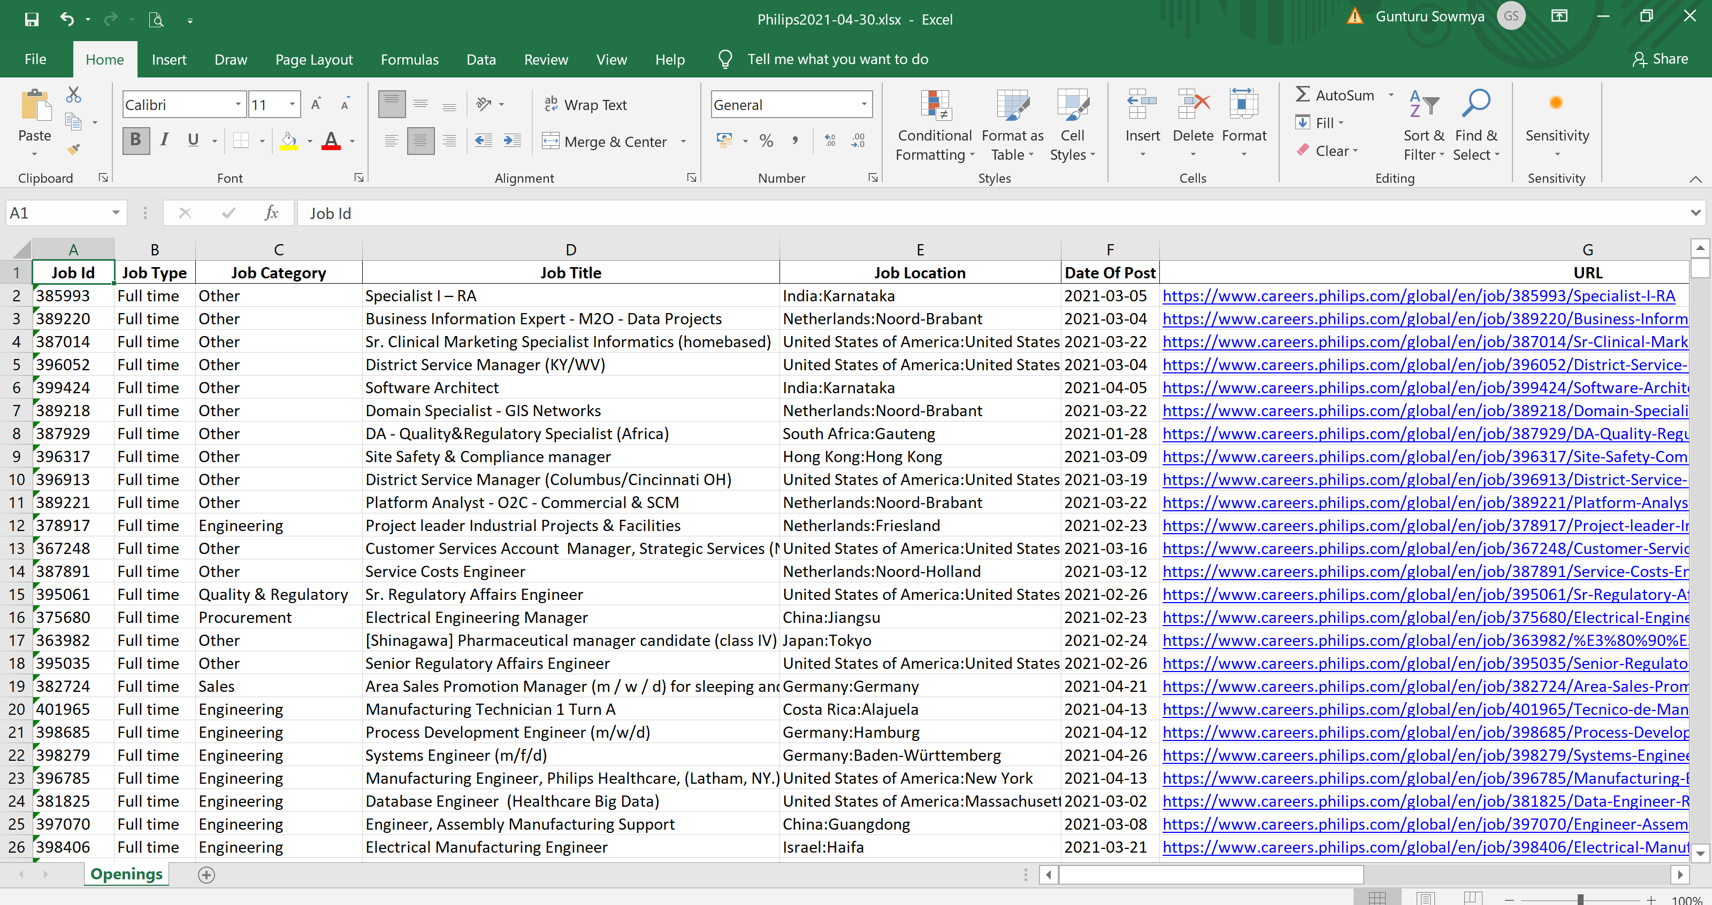
Philips Report

Slide 4
BI-APP Updates
Abbott:-
Changes were made on Front end side of the Abbott career hence the changes were made in code accordingly
Executed and generated report for the same and sent for production
FMC:-
Changes were made in the FMC website which resulted in incorrect Job Titles in the report
Modified the code, executed and generated report for the same and sent for production

Slide 5

Thank You

